Slide 1

Biogas Production from Agricultural Waste in Egypt
Done by:
Abrar Meshref Alaa Rady
Ahmed Maher Ahmed Mohamed
Hossam Mostafa Mohamed Nagah
Supervisor:
Dr. Mohammed Selim

Slide 2
Agenda
01
PROBLEM VS. SOLUTION
02
ALL ABOUT THE PRODUCT
03
MARKET & COMPETITION
04
BUSINESS MODEL PRODUCT
01
02
03
04

Slide 3
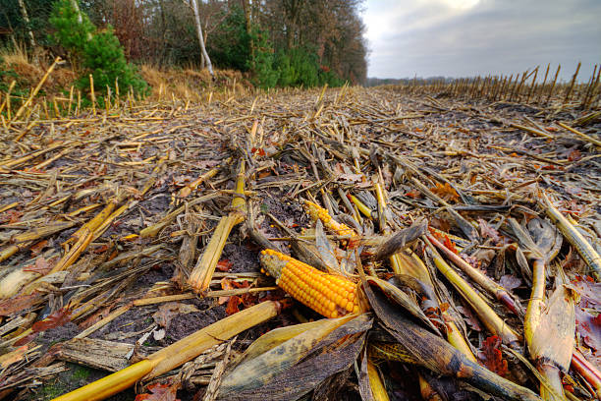
INTRODUCTION
Turning agricultural waste into biogas offers Egypt a sustainable energy solution while mitigating waste issues. This initiative not only promotes eco-friendly practices but also fuels economic growth in rural areas, showcasing the power of innovation and environmental stewardship.

Slide 4
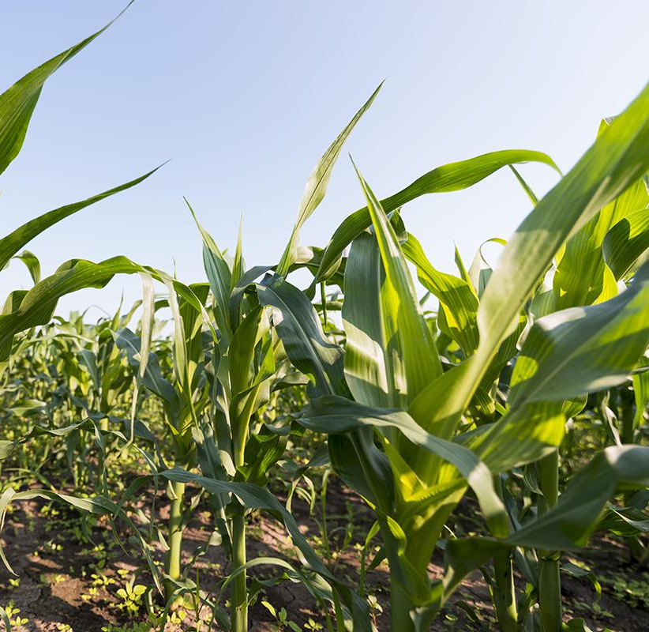
PROBLEM VS. SOLUTION
01

Slide 5
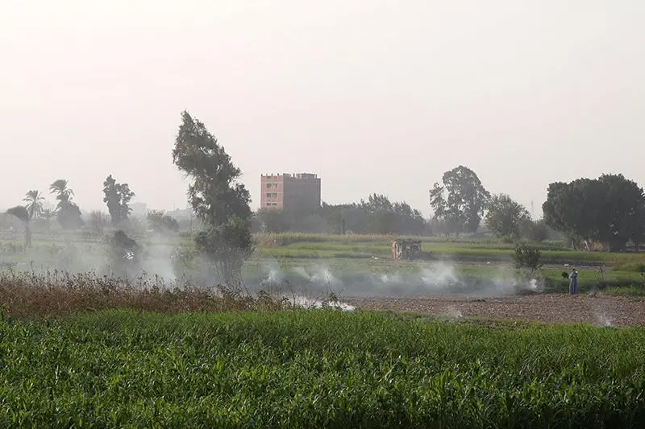
THE PROBLEM
Current energy sources in rural Egypt are unsustainable, leading to environmental degradation, high costs, and reliance on non-renewable resources.
Agricultural waste is often underutilized, contributing to waste management issues and missed opportunities for renewable energy production.

Slide 6
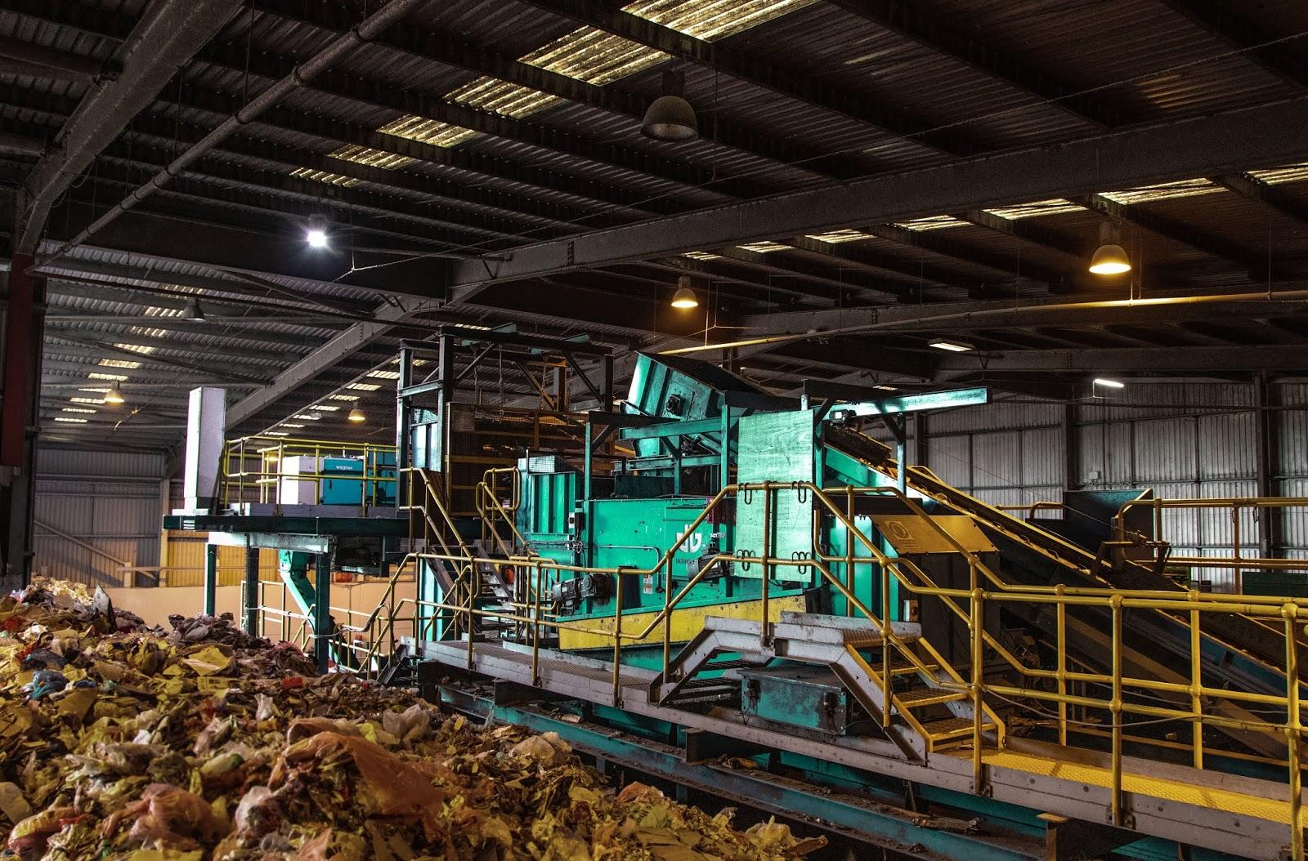
THE SOLUTION
The biogas production facility will leverage agricultural waste as a valuable resource, transforming it into biogas through anaerobic digestion.
This process not only addresses waste management challenges but also provides a sustainable energy solution, offering benefits such as reduced greenhouse gas emissions, decentralized energy production, and economic opportunities for local communities.

Slide 7
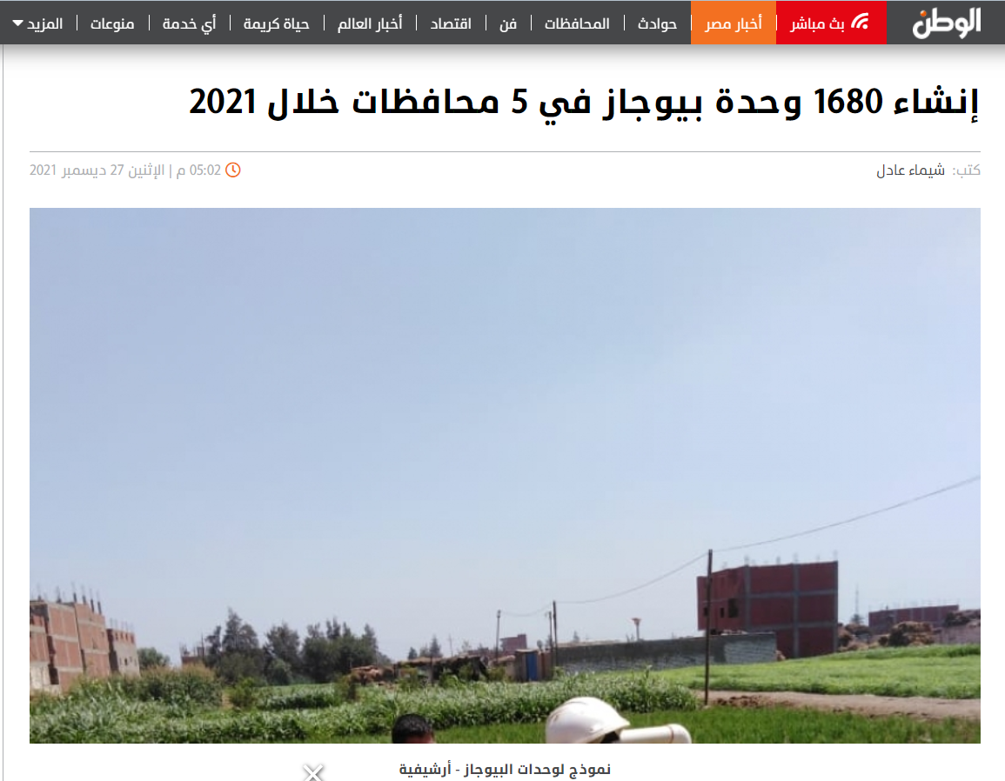

Slide 8
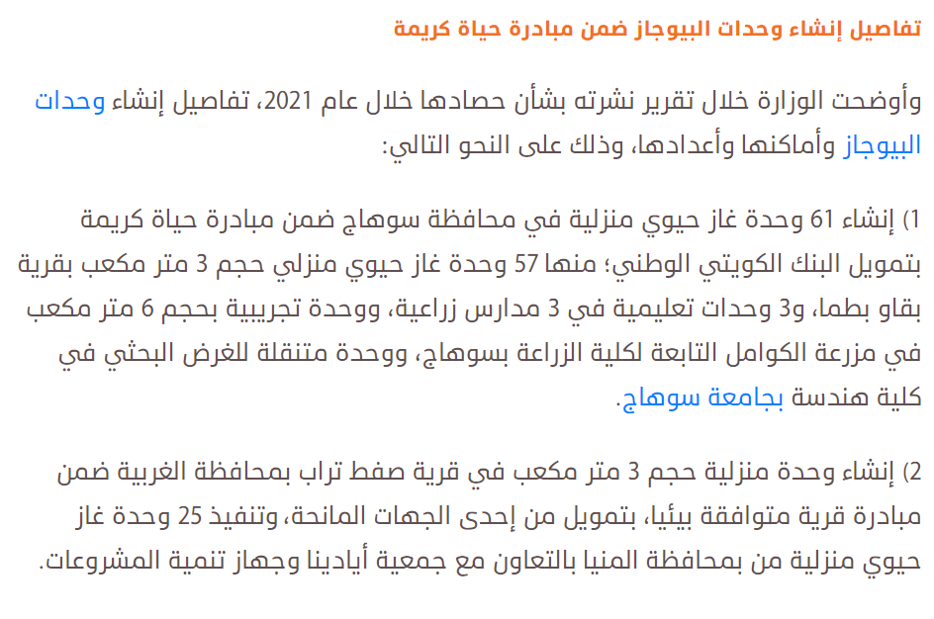

Slide 9
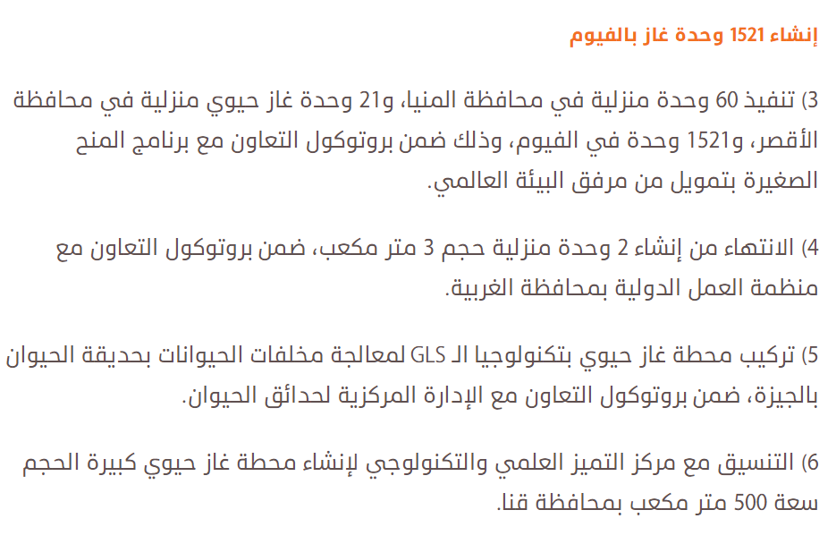

Slide 10


Slide 11
SWOT ANALYSIS
STRENGTHS
WEAKNESSES
OPPORTUNITY
THREATS
1-Renewable Energy Source
2-Environmental Benefits
3-Waste Management
4-Local Economic Development
1-Initial Investment
2-Technical Expertise
3-Market Acceptance
4-Infrastructure
S
W
1-Government Support
2-Partnerships
3-Technology Advancements
O
T
1-Market Volatility
2-Competitive Market

Slide 12
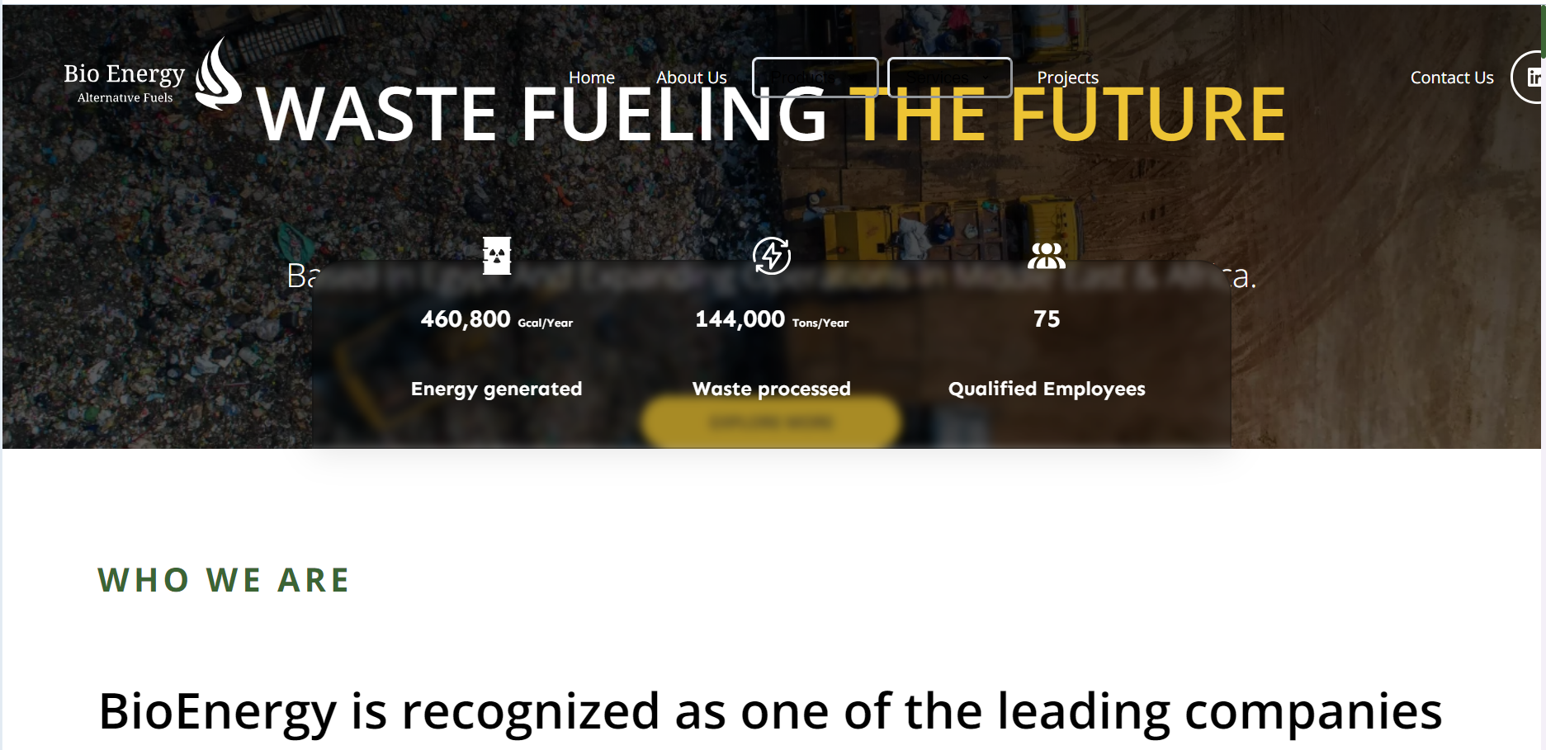
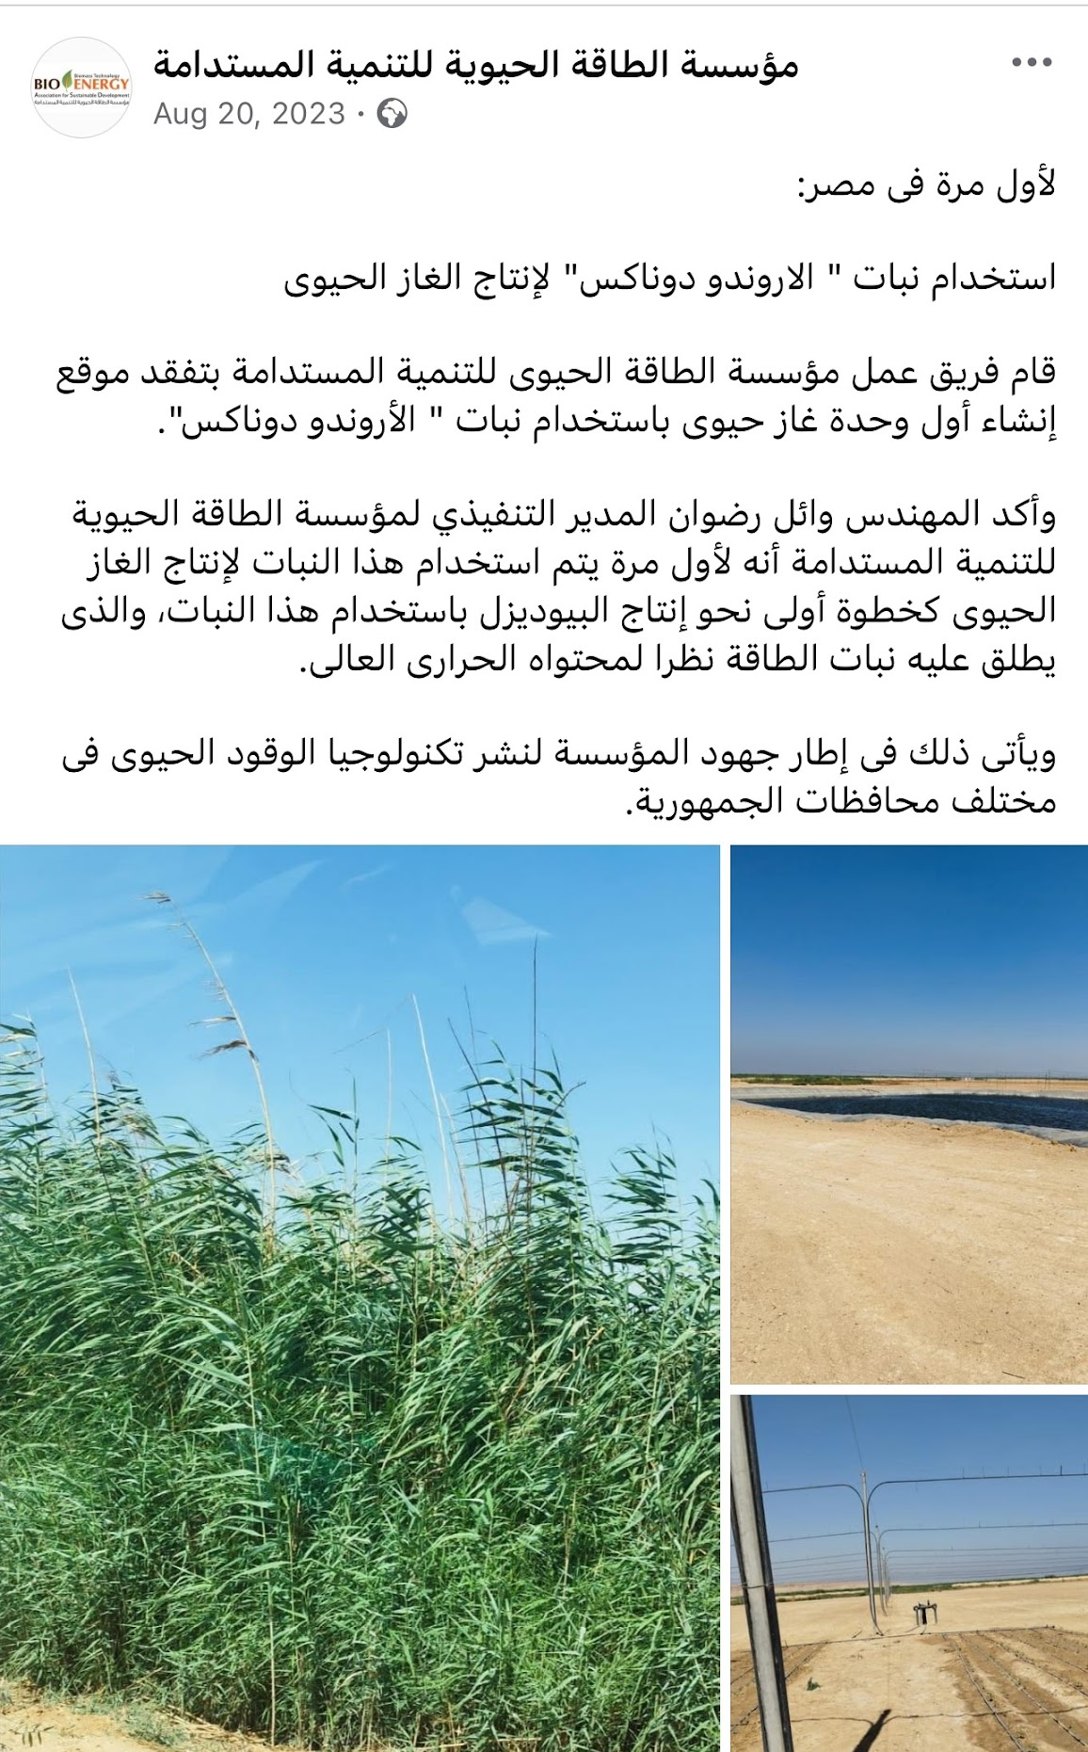
COMPETITORS

Slide 13
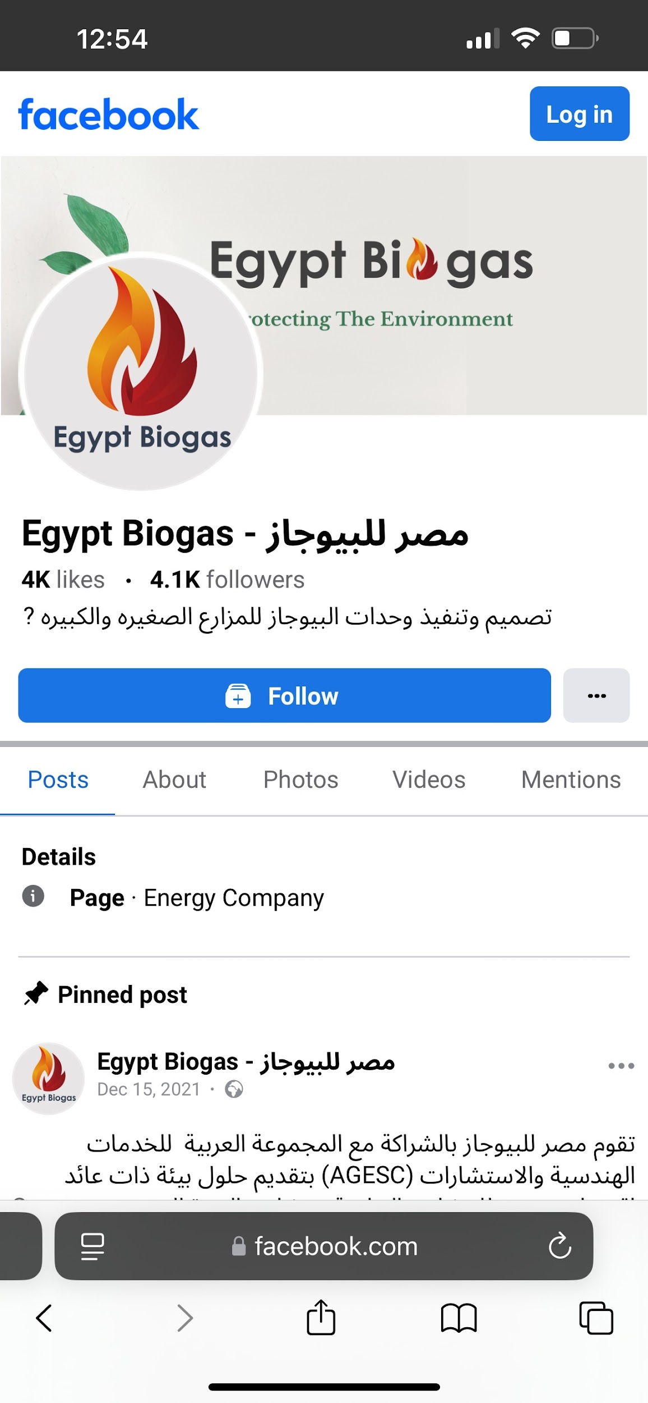
COMPETITORS

Slide 14
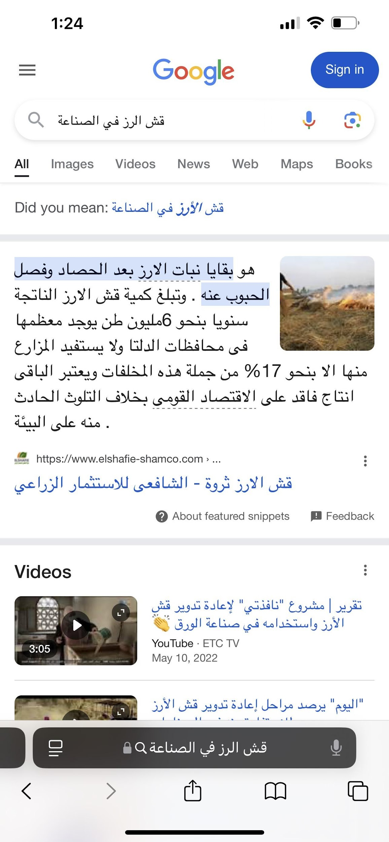

Slide 15
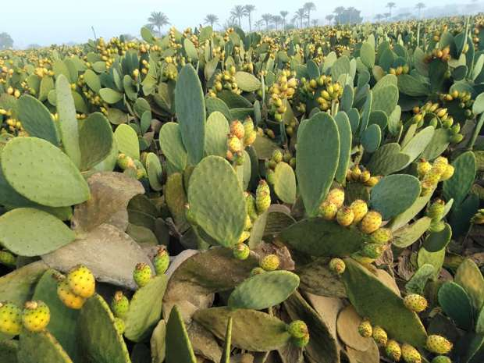

Slide 16
Fund
5,100,000
If you got
This is all we need to start the project from scratch

Slide 17
TIMING It will only take 68 weeks
Week 1-4
5-12
13-24
25-48
49-60
Project
Initiation
Feasibility Study
Design and Planning
Construction Phase
Operation Phase
Project Kickoff
Stakeholder Identification
Risk Management Planning

Slide 18
TIMING It will only take 68 weeks
61-64
Week
65-68
Monitoring and Reporting
Project Closure Phase

Slide 19
Resources
Project Initiation | Feasibility Study | Design and Planning | Construction Phase | Monitoring and Reporting | Operation Phase | Project Closure
Project Managers | Market Analysts | Site Selection Specialists | Construction Workers | Performance Analysts | Operations Managers | Project Evaluators
Stakeholder Engagement Specialists | Technical Experts | Biogas Plant Design Engineers | Engineers | Environmental Impact Reporters | Trainers | Stakeholder Feedback
Risk Management Experts | Financial Analysts | Project Planners | Equipment Operators | Financial Analysts | Technicians | Coordinators Documentation Specialists
 | Environmental Consultants

Slide 20
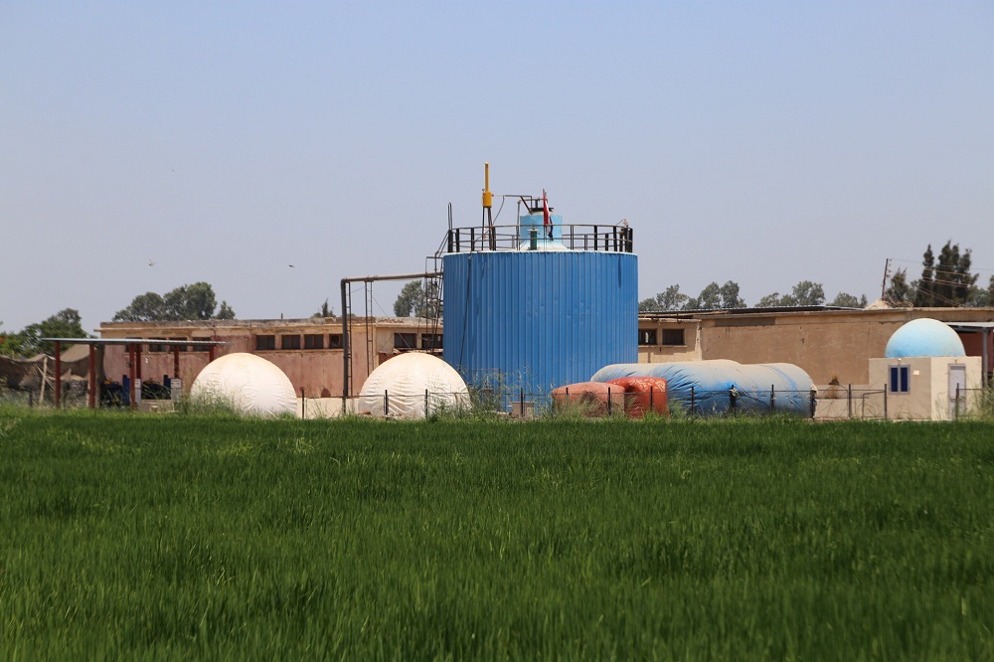
If we used construction of biogas industry
In Egypt

Slide 21
Fund will decreas
1,370,000
If you got
This is all we need to start the project

Slide 22
TIMING It will only take 33 weeks
Week 1-4
5-12
13-24
25-48
49-60
Project
Initiation
Feasibility Study
Design and Planning
Construction Phase
Operation Phase
Project Kickoff
Stakeholder Identification
Risk Management Planning

Slide 23
TIMING It will only take 68 weeks
61-64
Week
65-68
Monitoring and Reporting
Project Closure Phase

Slide 24
Resources
Project Initiation | Feasibility Study | Design and Planning | Construction Phase | Monitoring and Reporting | Operation Phase | Project Closure
Project Managers | Market Analysts | Site Selection Specialists | Construction Workers | Performance Analysts | Operations Managers | Project Evaluators
Stakeholder Engagement Specialists | Technical Experts | Biogas Plant Design Engineers | Engineers | Environmental Impact Reporters | Trainers | Stakeholder Feedback
Risk Management Experts | Financial Analysts | Project Planners | Equipment Operators | Financial Analysts | Technicians | Coordinators Documentation Specialists
 | Environmental Consultants

Slide 25
Common Resources
Human Resources:
Skilled labor for construction and operation
Project management team
Administrative staff
Material Resources:
Construction materials (concrete, steel, etc.)
Biogas production equipment
Monitoring systems
Financial Resources:
Budget for construction, operation, and maintenance
Funding for feasibility studies and environmental assessments

Slide 26
Additional Resources
Technology Resources:
IT infrastructure for project management and monitoring
Software for design and planning
Environmental Resources:
Waste collection systems
Digestate processing units
Supplier Resources:
Identification and selection of suppliers for equipment and materials

Slide 27
Thank you all for being part of this journey. I would like to extend my sincere appreciation to our instructor for their guidance and support throughout this training. Their expertise and dedication have truly made a difference. I also want to thank everyone involved in organizing this online training. Your efforts in creating a structured and engaging learning environment have been invaluable

